Slide 1

QUIZZERIA
Prepared By:
Sakina Sabunwala
Habiba Kurabar
Amisha Mathur
Lakshita Paliwal
Nahid Akhtar

Slide 2
Anagrams
Introduction: An anagram is a word or phrase formed by rearranging the letters of a different word or phrase, typically using all the original letters exactly once.[1] For example, the word anagram can be rearranged into "nagaram".
The original word or phrase is known as the subject of the anagram. Any word or phrase that exactly reproduces the letters in another order is an anagram.
Applications:
1.Establishment of priority
2. Games and puzzles

Slide 3
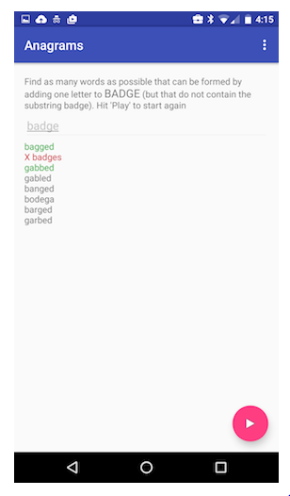
The UI for our game will look like this:

Slide 4
Scarne’s Dice
Scarne's dice is a dice game in which you have to reach 100 before the computer does. Make maximum score in a turn without rolling a one. If you roll a one your turn score becomes zero. If you feel that you may get a one in the next roll. You can hold on with your score and let the computer play.

Slide 5
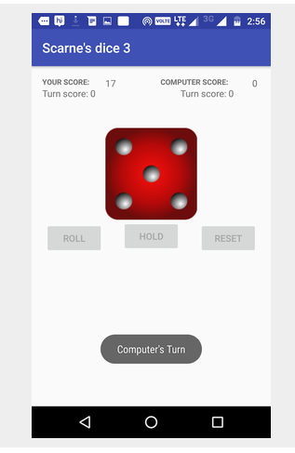
The UI for our game will look like this:

Slide 6
Word Stack
The idea of the game is to try to separate out two words of the same length whose letters have been scrambled (but the order of the letters has been preserved).
Applications of stacks :
1. Compile time memory management
2. Efficient algorithms

Slide 7
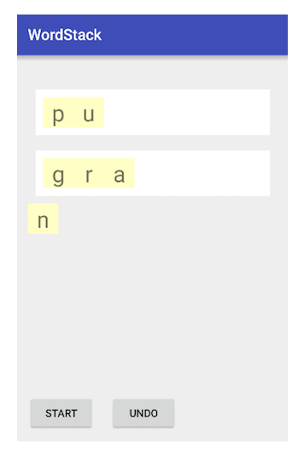
This is what the app looks like part way through a game where the two words are 'grads' and 'punks':

Slide 8
Ghost
Ghost is a word game in which players take turns adding individual letters to a growing word fragment, trying not to be the one to complete a valid word. Each fragment must be the beginning of an actual word, and, for our purposes, we will consider 4 to be the minimum word length. The player who completes a word or creates a fragment that is not the prefix of a word loses the round.
#So on player 1's turn, they can:
challenge player 2's word if they think player 2 has formed a valid word of at least 4 letters. If the fragment is a word, then player 1 wins; if the fragment is not a word, then player 2 wins.
challenge player 2's word if they think that no word can be formed with the current fragment. Then, player 2 must provide a valid word starting with the current fragment or lose.
add a letter to move the fragment towards a valid word
attempt to bluff player 2 by adding a letter that doesn't move the fragment towards a valid word.

Slide 9
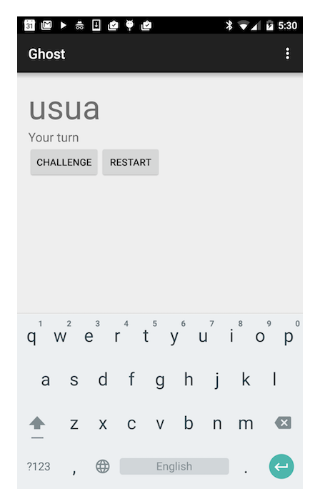
The UI for our game will look like this:

Slide 10
Quizzeria
The quiz consists of a total of 10 questions of the respective field selected .
The player should select one of the four answers namely a,b,c,d for the respective questions.
He can then move to the next question by clicking “Next”.
He can also quit the quiz by clicking “Quit” and then he would be moved to the start menu.

Slide 11
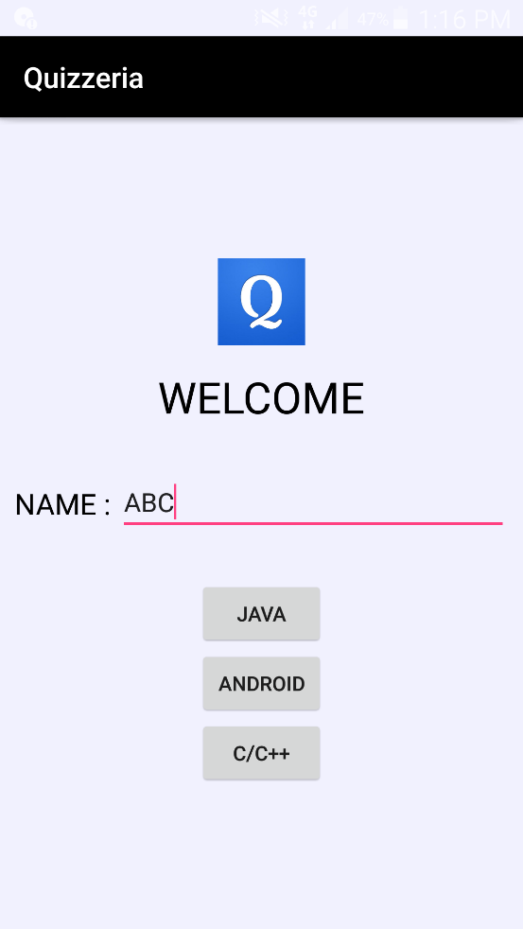
Start Menu
The player should enter his/her name here.
One of the four options (Android/Java/C/C++) should be selected to start the quiz.

Slide 12
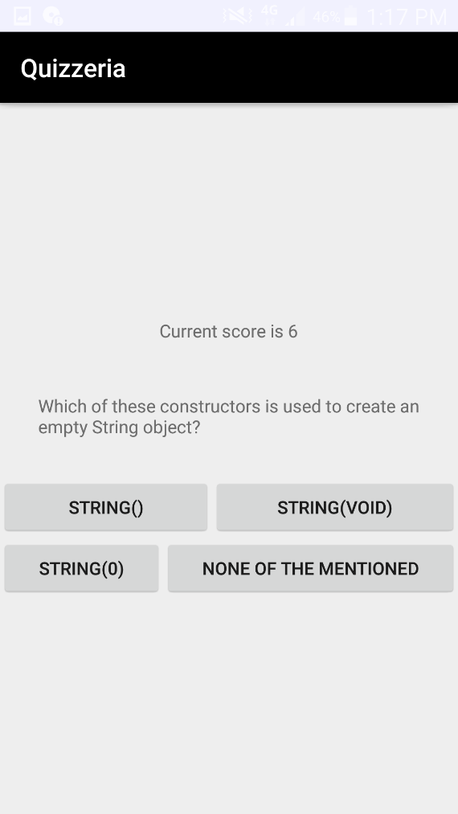
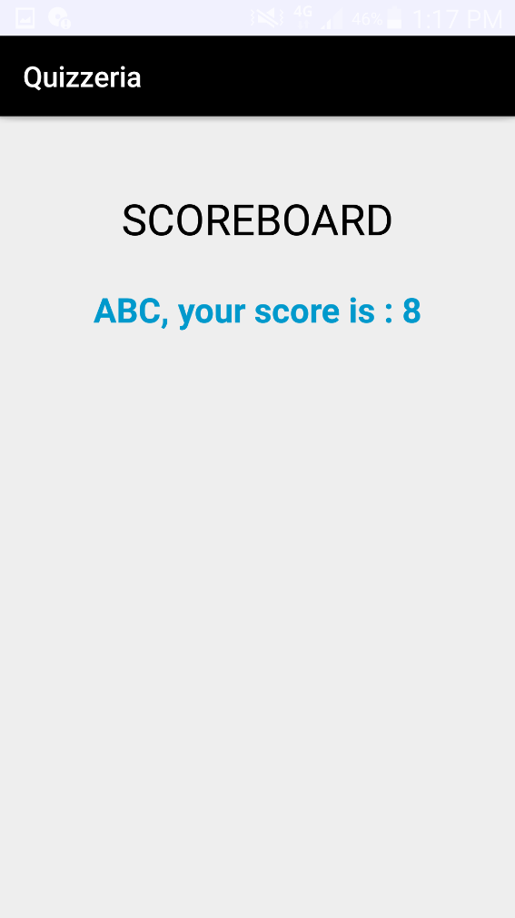
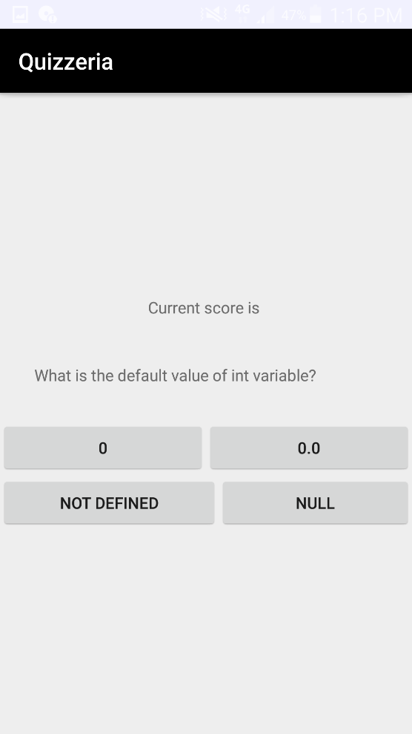
Score
Each correct answer would award two mark to the total score of the player.
The total score would be displayed either when the player answers all the 10 questions or quits.

